Slide 1
DoorDash Streamlines Data Management with Snowflake
INDUSTRY CASE STUDY
DATA 225 GROUP 4
Chelsea Jaculina, Manjot Singh, & Sai Prasad Thalluri
May 8, 2024
Notes:
Industry Slides
Chelsea - 1, 2, 3, 4
Sai - 5, 6, 7
Manjot - 8, 9, 10

Slide 2
DoorDash - Introduction
A leading online food ordering and delivery services platform founded in 2013
Operating in more than 4,000 cities, DoorDash’s daily operations generates high volume of transactions and data
Doordash partnerships with over 450,000 merchants across countries like US, Canada, and Australia.
Doordash's operational efficiency and data-driven decision-making is the use of innovative technologies, such as Snowflake.
Notes:
DoorDash operates in more than 4,000 cities across the United States, Canada, and Australia and partners with over 450,000 merchants to provide customers with a wide variety of food and drink options. Given the high volume of transactions and data generated by DoorDash’s daily operations, the firm needs a robust and scalable data management solution to effectively manage and analyze its vast data.

Slide 3
Traditional Data Warehousing
A type of data management system that is designed to support business intelligence analytics
Intended to perform queries and analysis on large amounts of historical data
Centralizes and consolidates large amounts of data from multiple sources
Allows organizations to derive valuable business insights to improve decision making while keeping a historical record

Slide 4
Advantages/Benefits of Traditional Data Warehousing
Data warehouses are powerhouses for analyzing massive datasets and extracting valuable insights:
Subject-Oriented: Analyze data about a particular subject or function
Integrated: Creates consistency among different data types from various sources
Non-Volatile: Once data is in the warehouse, it’s stable and doesn’t change
Time-Variant: Ability to keep a historical record

Slide 5
DoorDash’s Legacy
Data Warehouse Method
DoorDash’s data architecture struggled to keep up with the company’s increase of data across data silos
Limitations in terms of scalability and agility
Challenging to extract deep insights from its data and make time-sensitive decisions

Slide 6
Snowflake
A cloud-based data warehousing system that enables the effective storage and analysis of large data sets
Acts as a Service as a Software (SaaS)
Designed for companies that need to handle vast amounts of data and run virtually unlimited number of concurrent workloads

Slide 7
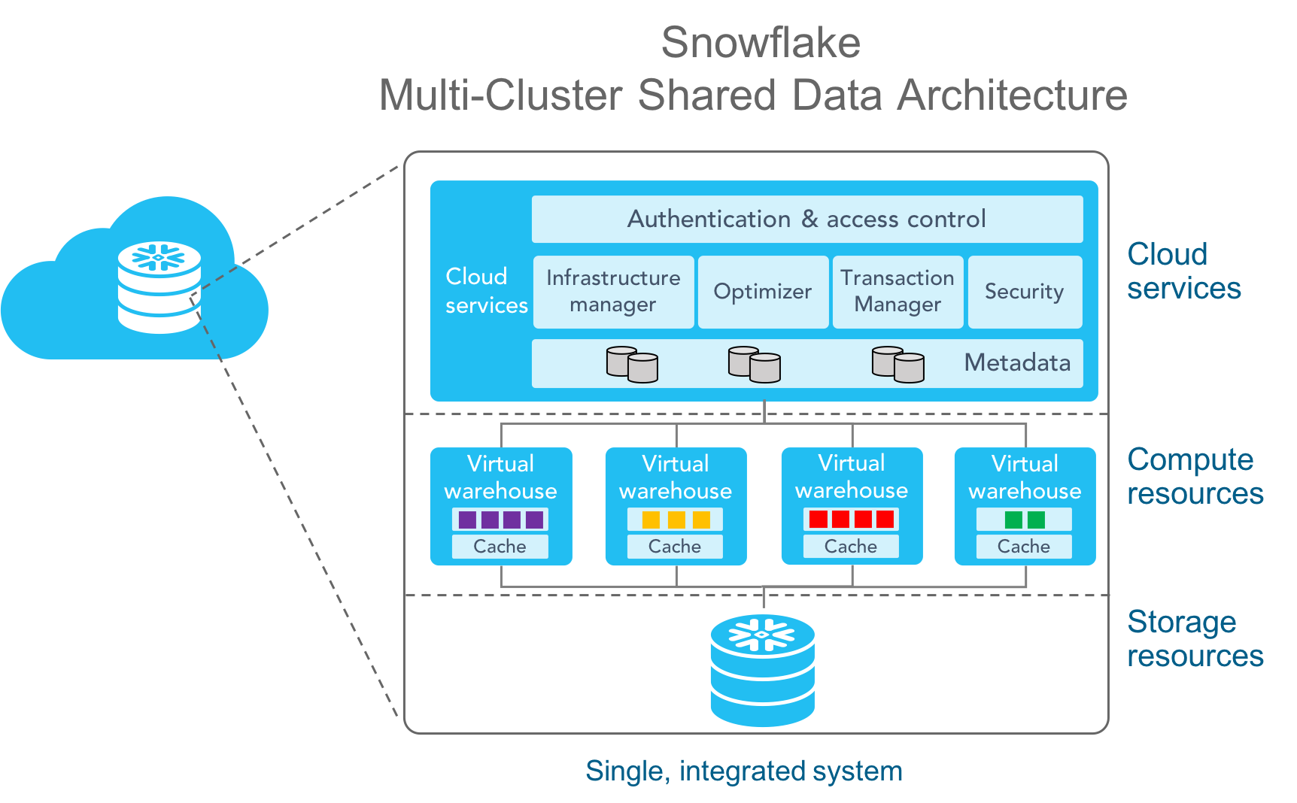
How DoorDash Utilizes Snowflake
To effectively manage the vast amount of data being collected, DoorDash adopted Snowflake
DoorDash utilizes Snowflake’s multi-cluster shared data architecture
Separates storage and computer resources which allows independent scaling of each
While queries are running, compute resources can scale without disruption or downtime, and without the need to redistribute data
Can automatically detect when scaling is needed without user involvement

Slide 8
Advantages of using Snowflake for DoorDash
Scalability: easily grow storage and process data without compromising on performance or speed
Data Handling: can handle different data types from various sources
Ease of Use: supports SQL-based queries, making data analysis simpler for DoorDash’s data team
Security: offers strong security features like encryption
Cost-Efficiency: only pay for resources used
Performance: allows data to be analyzed quicker for faster decision-making

Slide 9
Comparison: Traditional Data Warehouse vs Snowflake
Comparison | Traditional Data Warehouse | Snowflake
Scalability | Limited scalability | Highly scalable storage and processing based on demand
Data Handling | Struggles with various data types | Handles diverse data types from multiple sources (transactions, customer data, operational data)
Querying | Complex queries | Uses familiar SQL queries for easier data analysis
Security | Limited security features | Advanced security features like encryption and access controls
Cost | High upfront costs and ongoing maintenance | Pay-as-you-go model, reduces costs
Performance | Slower performance with large data volumes | Fast data processing and analysis

Slide 10
Key Learnings
DoorDash’s switch from the Traditional Data Warehouse to Snowflake’s cloud-based data warehousing platform has revolutionized how the company manages their excessive volumes of data.
Snowflake’s scalability, agility, and robust security empower DoorDash to collect and analyze data such as delivery routes in real time.
The topics studied in this course are relevant to the industry’s standard practices and processes.

Slide 11
References
Key Concepts & Architecture — Snowflake Documentation. Docs.snowflake.com. (2022). Retrieved 24 April 2024, from https://docs.snowflake.com/en/user-guide/intro-key-concepts.html.
RTS Labs. (2023, April 4). Streamlining data management with Snowflake: A case study. Retrieved 24 April 2024, from https://rtslabs.com/streamlining-data-management-with-snowflake-a-case-study/
What is a Data Warehouse?. Oracle.com. (2022). Retrieved 25 April 2022, from https://www.oracle.com/database/what-is-a-data-warehouse/

Slide 12
THANK YOU!
ANY QUESTIONS?

